Slide 1
DEAP 4.2 – Advisory Report 15th June 2021

Slide 2
Advisory Report Trial
28 assessors participating
Timelines
December 2020 – AR builder enabled for participating assessors
January 2021 – invited to provided feedback
May 2021 – completion of further development on builder and on DEAP4/NAS integration
8th June 2021 - launch of transitionary period and the updated advisory report tool for all domestic BER assessors
6th July 2021 – Updated advisory report becomes official BER document and current advisory report retired

Slide 3
Advisory Report Trial
Feedback
Advisory report builder - UI, software application, recommendations etc
Supports for assessors (technical document, BER leaflet for HOs, any additional supports?)
Any homeowner feedback

Slide 4
Generating official BER documents
Send to NAS
View survey in NAS
Go through usual process to generate official BER documentation – BER cert and existing advisory report
Issue official documentation to clients as usual

Slide 5
Generating draft advisory report
This step is optional for now.
‘Generate Advisory Report’ enabled when survey is sent to NAS
New function generates the draft AR
The draft AR will not appear in NAS until existing AR is retired
Draft can be issued in addition to the official advisory report along with information leaflet for HOs explaining the trial
After 6th July, there won’t be a ‘Generate Advisory Report’ button – it will be generated in the same manner as now

Slide 6
DEAP 4.2 – Advisory Report

Slide 7
Content
Overview
Advisory Report Tool: a roadmap
Logic & Approach
Upgrade Measures & Recommendations
Dependencies
Minimum-Target Upgrade Level
Worked Examples

Slide 8
Introduction
Different audiences for the report
Address needs of different users

Slide 9
Questions
We will try and answer as many as we can
Questions may be submitted to the Helpdesk
Generate an FAQ, or similar, to address all

Slide 10
Overview

Slide 11
Advisory Report tool: Roadmap
Significant improvement on existing Advisory Report
Help homeowner better understand energy performance of their home
Build personalised package of upgrades to improve energy efficiency of their home
Opportunity for assessors to sell their skills in a consultancy role

Slide 12
Advisory Report tool: Roadmap
Assessor builds a package of measures for that home to significantly improve BER
Delivered in one project or over time (e.g. BRP)
Colour coding to illustrate the current and potential energy performance
Indicative level of investment for upgrades

Slide 13
Logic & Approach
Homeowners need guidance on where to start
Fabric first, heating, renewables, other measures
The full spectrum of upgrades is provided for
Heat Loss Indicator (HLI)

Slide 14
Upgrade Measures & Recommendations
Suite of potential upgrades is based on existing performance
Thresholds – these determine list of measures
Upgrade values – the performance values of upgrades
Automatic selection of measures
Dependencies
Heating fabric selected with notification
Renewables fabric + heat pump selected with notification

Slide 15
Threshold & Upgrade values - Fabric
Upgrade | Upgrade option available when | Upgrade Value
Wall | ˃0.44 | 0.35 / 0.27 / 0.18
 | ˃0.36 | 0.27 / 0.18
 | ˃0.27 | 0.18
Roof | ≥0.20 / 0.35 / 0.35 (ceiling / slope / flat) | 0.16 / 0.20 / 0.22
Windows | ˃1.49 | 1.4 / 0.8
 | ˃0.89 | 0.8
Doors | ≥2.7 | 1.4
Floors | ˃0.45 | 0.36 / 0.18 / 0.15
 | ˃0.27
 |  | 0.18 / 0.15
 |  | 0.15
 | ˃0.24

Slide 16
Threshold & Upgrade values – Main Space Heating
Upgrade to | Upgrade when (system / efficiency) | Optimum
Heat Pump | Any, efficiency ≤ 100% | SH: 350%, DHW: 200% ^{1, 2}
New boiler | Gas/oil boiler ≤ 86% Electric heating = 100% | Gas/oil boiler 90% efficient ³
Biomass boiler | Gas/oil boiler ≤ 77% Electric heating = 100% | Biomass boiler, 77% efficient ³
Electric heating | Electric heating | Electric heating ³
Solid fuel boiler | Solid fuel, ≤ 70% | Solid fuel boiler, 75% efficient
HLI to be ≤ 2.3 – warning where this is not met
If A2A, DHW is 100%
Set to control category 3

Slide 17
Optimal & Threshold values - Others
Secondary heating: if ≤ 30% improve to 60% (solid fuel) / 90% gas heater, chimney -1, flue +1
Renewable options presented if none in existing dwelling
Mechanical ventilation (MVHR, MEV) if natural ventilation
Simple measures, e.g., cylinder insulation/thermostat, draught stripping, draught seal of suspended timber floor all binary selections, e.g., if ‘Unsealed’ set to ‘Sealed’ etc.

Slide 18
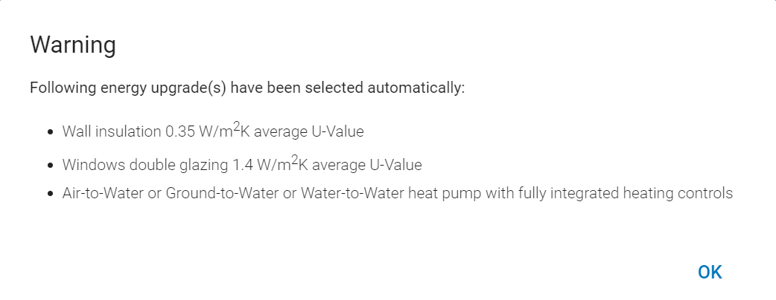
Measures & Dependencies
Only selected Roof insulation upgrade and then selected Solar PV
Assessor Selects | Automatically selected (if not already)
Floor insulation | Wall insulation, roof insulation, windows
Windows | Wall insulation, roof insulation
New boiler / biomass boiler | Wall insulation, roof insulation
Renewables | Wall insulation, roof insulation, windows, heat pump

Slide 19
Minimum-Target Upgrades
Current | Minimum | Target
G | D2 | B2
F | D2 | B2
E2 | D1 | B2
E1 | C3 | B2
D2 | C2 | B2
D1 | C1 | B2
C3 | B3 | B2
C2 | B3 | B2
C1 | B2 | B2
B3 | B2 | B1
B2 | B2 | B1
B1 | B1 | A3
A3 | A3 | A2
A2 | A2 | A1
A1 | A1 | A1
Minimum: to allow publication
Automatic selections will typically meet the minimum
Target: aligned with Climate Action Plan and Part L

Slide 20
Notifications: Errors & Warnings
Errors: Will prevent the publication of the Advisory Report
The selected measures do not achieve the Minimum rating
No additional measures selected (unless Minimum BER already achieved)
Warnings: indicate that additional work may be required
The selected measures do not achieve the Target rating
The HLI is > 2.3 and a heat pump is selected

Slide 21
Upgrade Builder

Slide 22
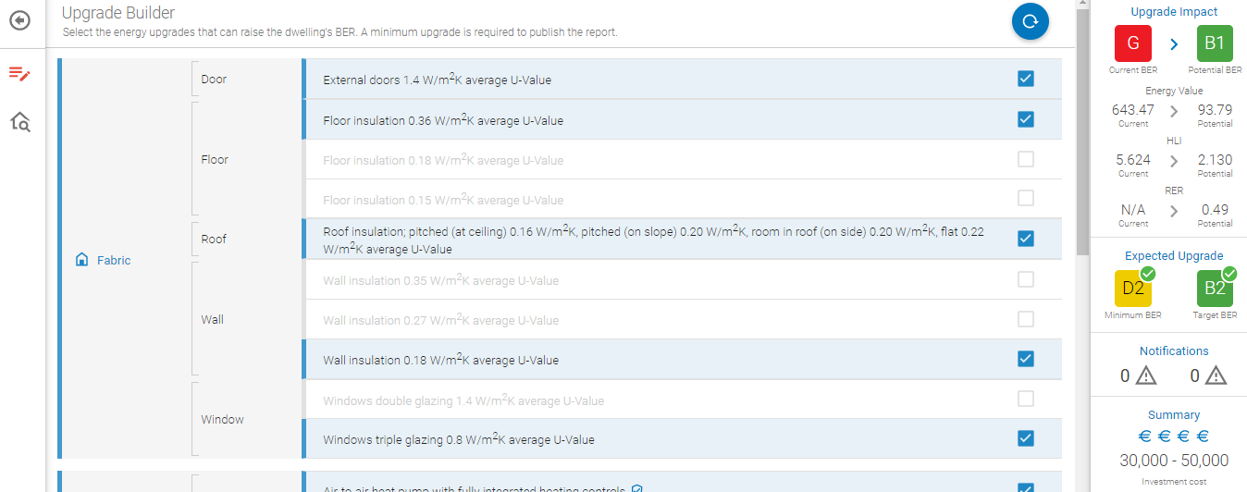
Sample Upgrade Builder
Reset selection
Upgrade Builder
Dwelling Characteristics
Potential Impacts
Potential Measures

Slide 23
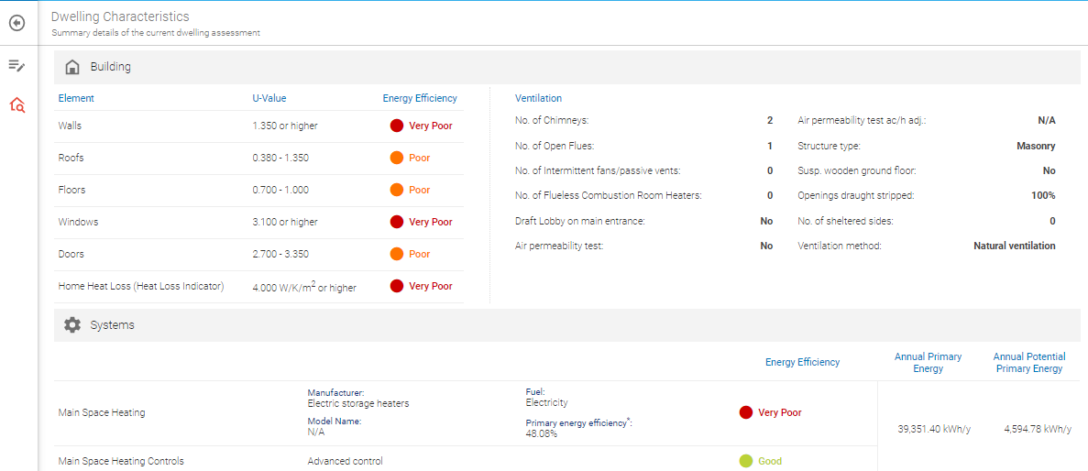
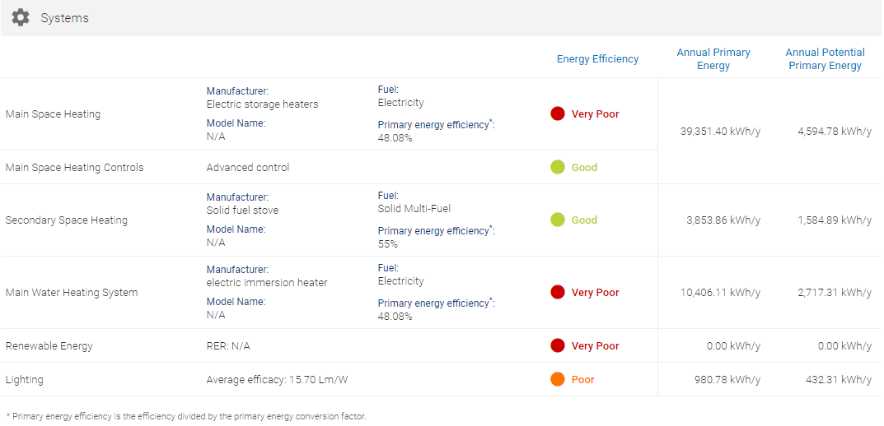
Dwelling Characteristics

Slide 24
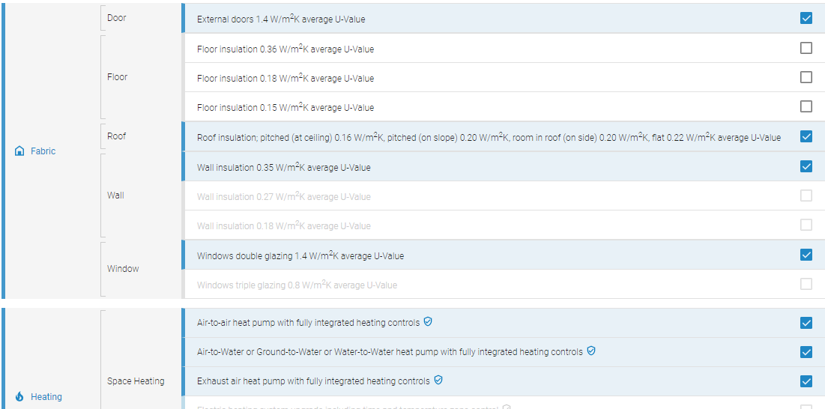
Sample Upgrade Builder – Automatic Selections

Slide 25
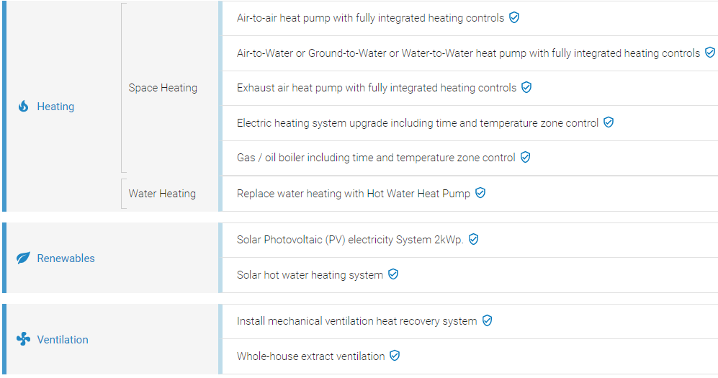
Sample Upgrade Builder – Additional Measures
Symbol denotes additional measures
Must select at least one (unless Minimum BER has already been achieved)

Slide 26
Sample Upgrade Builder
Starting BER > Potential BER
Starting rating > Potential rating
Starting HLI > Potential HLI
Starting RER > Potential RER
Minimum BER / Target BER
Errors & Warnings
Level of investment cost

Slide 27
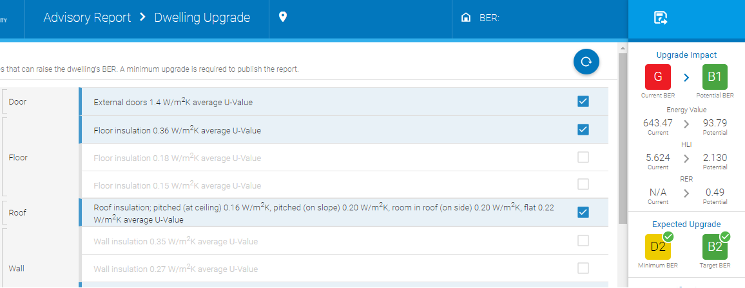
Generating Advisory Report

Slide 28
Sample Advisory Report
Page 1 – overview of the energy performance for the homeowner
Page 2 – Detail on the recommended measures
Page 3 – Technical detail
Page 4 – General information

Slide 29
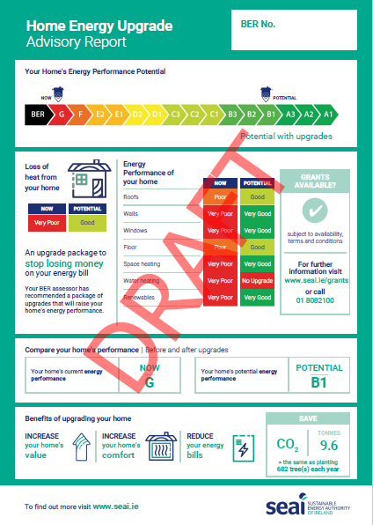

Slide 32
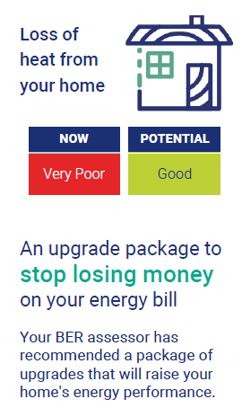

Slide 34
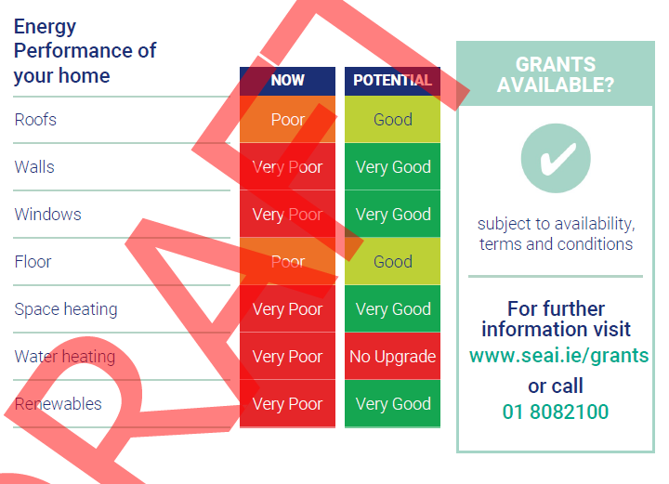

Slide 35
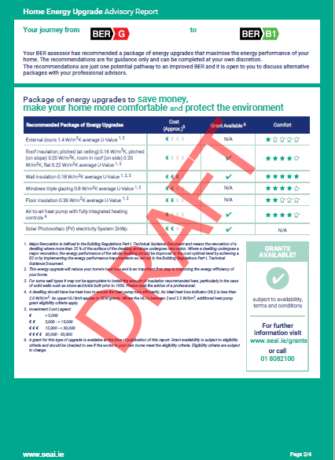

Slide 36
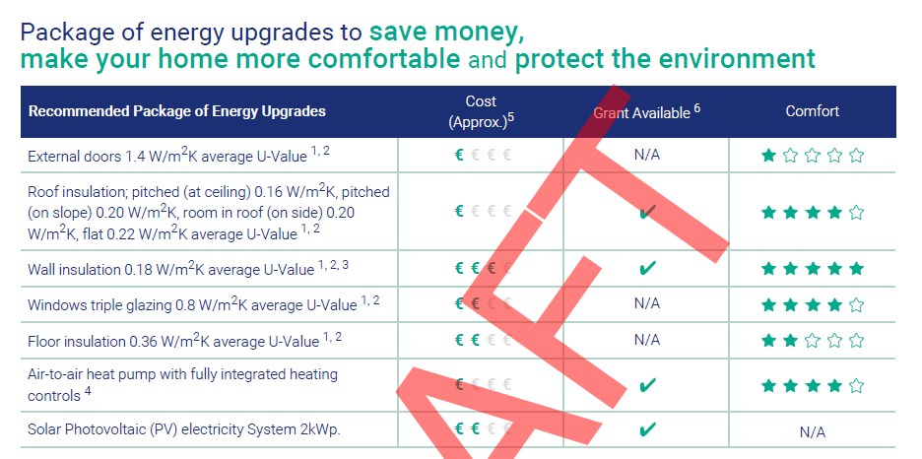

Slide 38
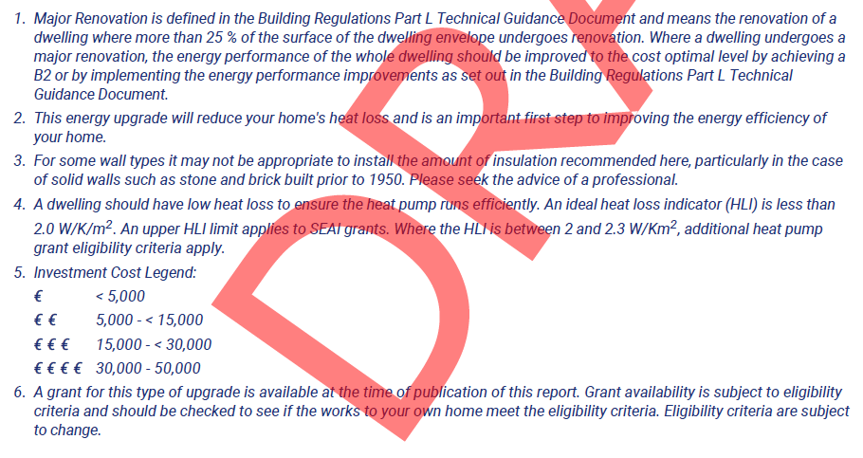

Slide 39
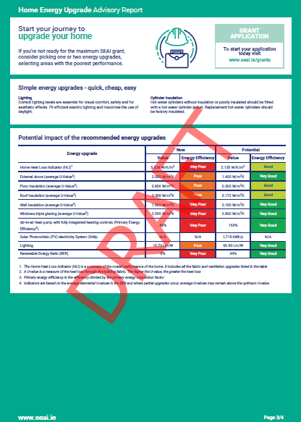

Slide 40
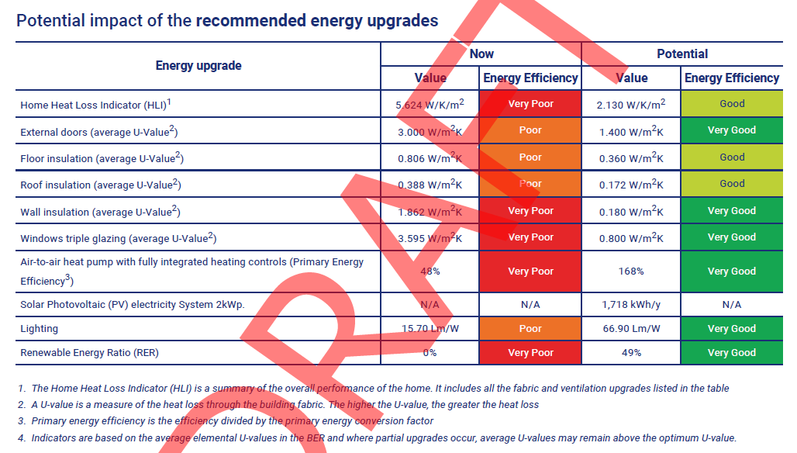

Slide 41
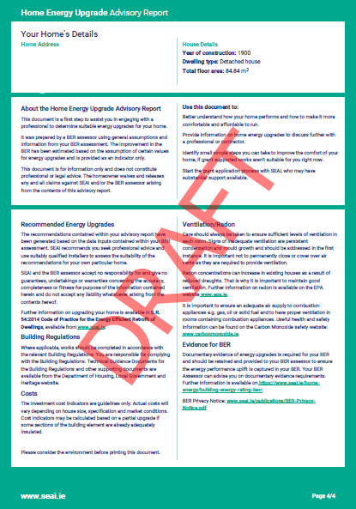

Slide 42
Worked Example
Starting rating: G

Slide 43
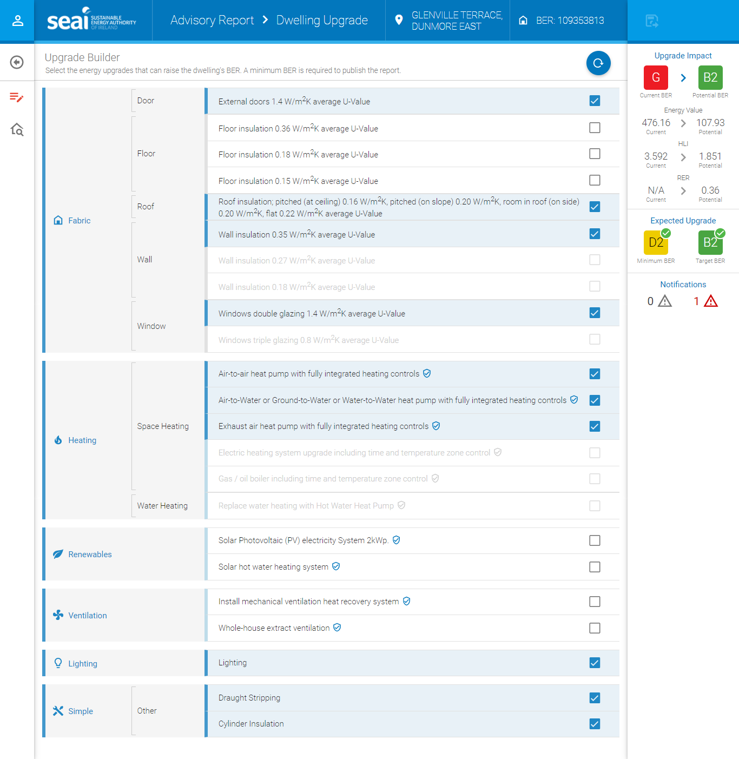

Slide 44
External Doors (1.4 W/m²K)
Roof Insulation (0.16/0.20/0.22 W/m²K)
Wall Insulation (0.35 W/m²K)
Windows (1.4 W/m²K)
Heat Pump options
Lighting
Draught stripping
Cylinder Insulation

Slide 45
Starting rating: G
Selected measures bring the rating from G to a B2
Selected measures bring the rating to 107.93 kWh/m²/yr
Selected measures bring the HLI to 1.851
Selected measures give an RER of 0.36
Meets Minimum upgrade rating (D2) and Target upgrade rating (B2)
Errors / Warnings
Indicative cost of implementing all selected measures

Slide 46
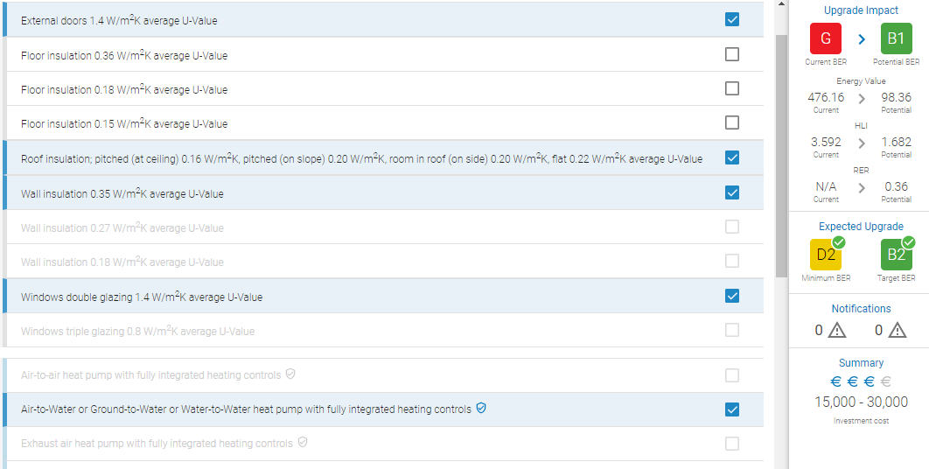
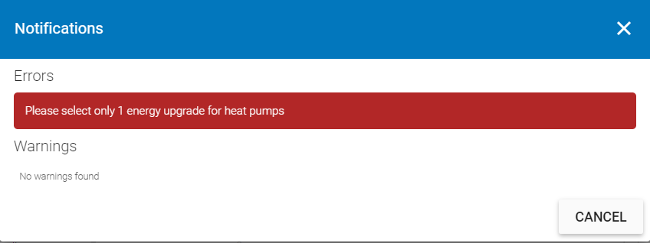

Slide 47
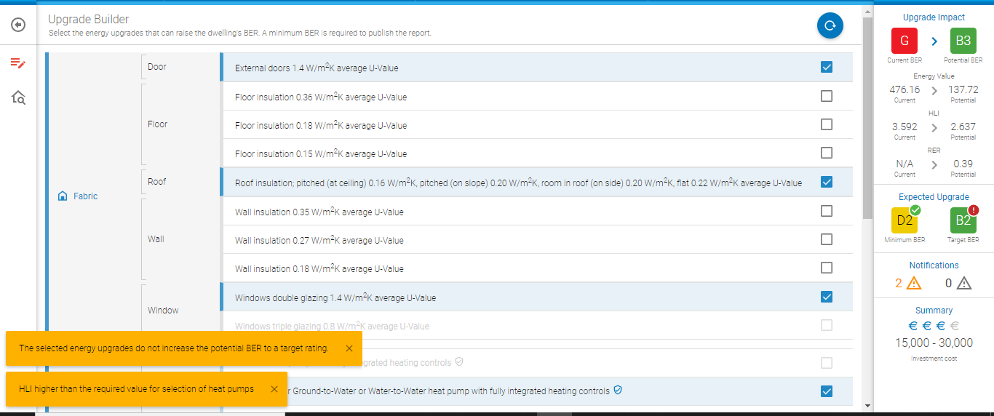
Heat Pump & HLI

Slide 48
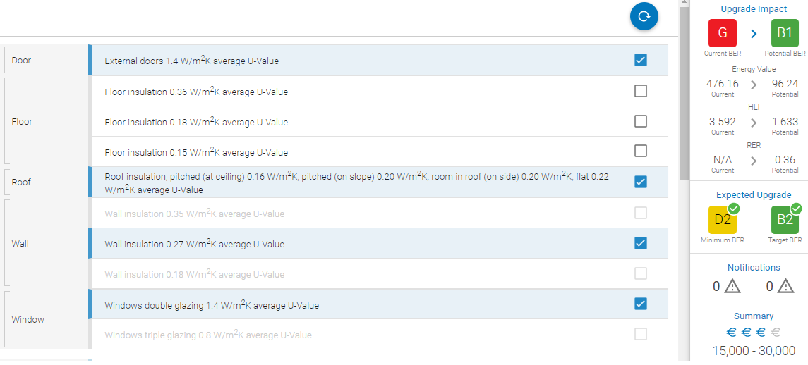
Heat Pump & HLI

Slide 49
Heat Pump & HLI
Sometimes, HLI > 2.3 even with roof, walls, windows and floor upgrade
Use DEAP to assess if there are areas within thresholds that may potentially warrant an upgrade
However, a heat pump may not be a realistic option

Slide 50
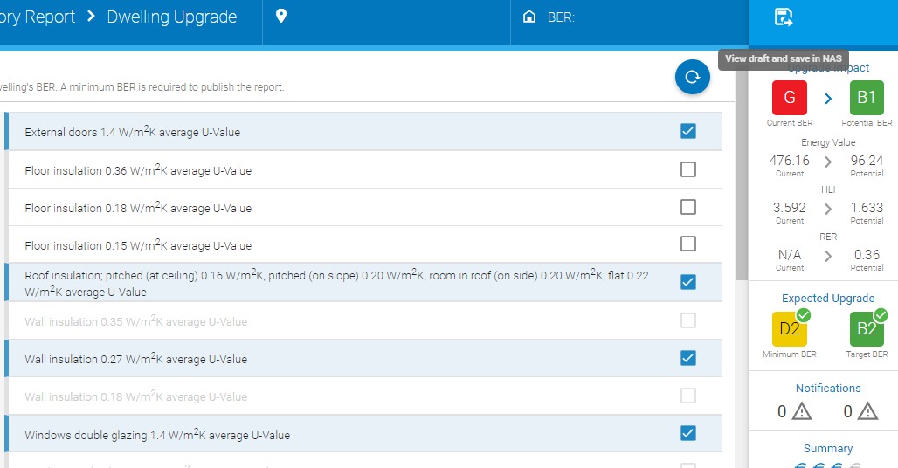
Generating Advisory Report

Slide 51
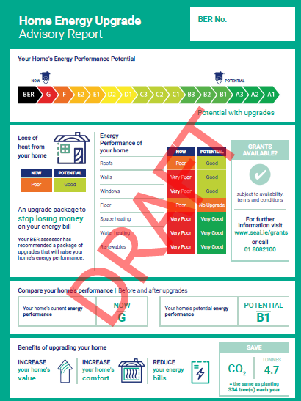
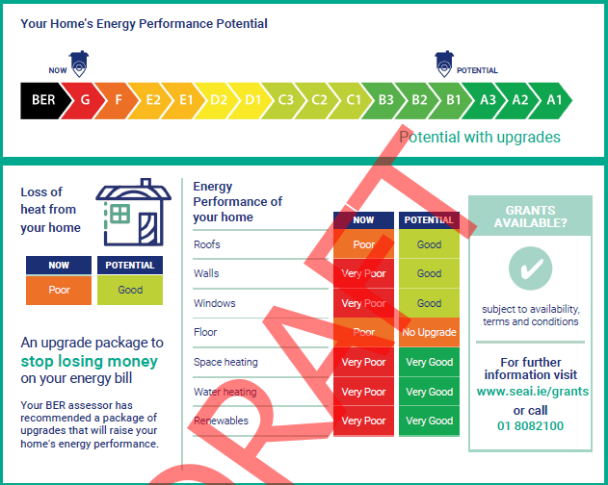

Slide 52
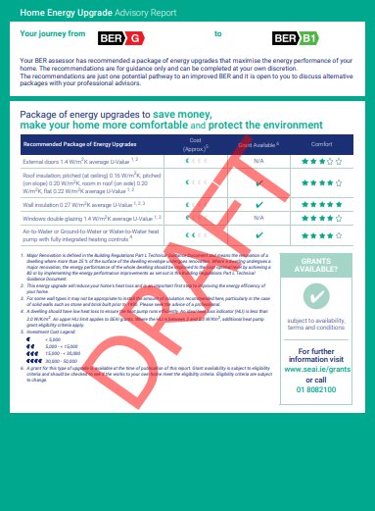
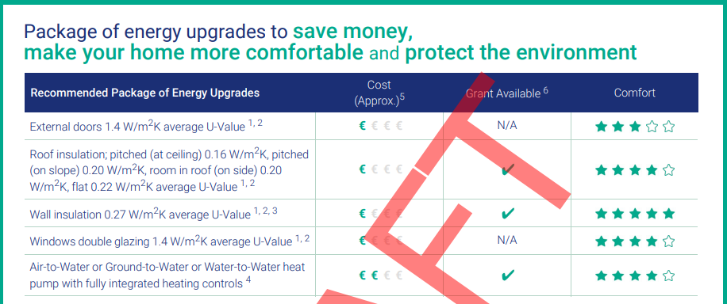

Slide 53
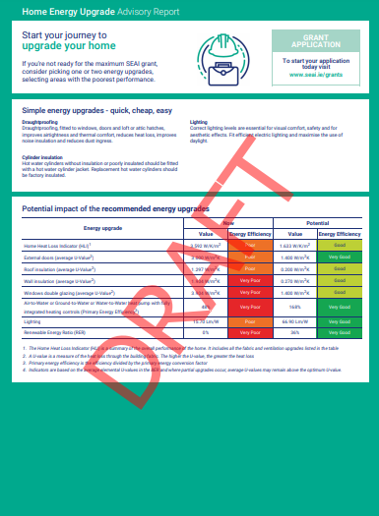
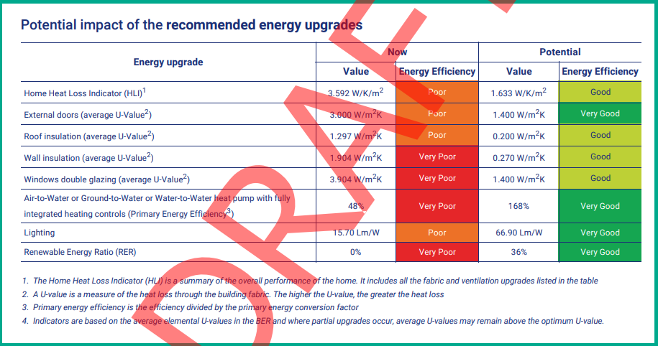

Slide 54
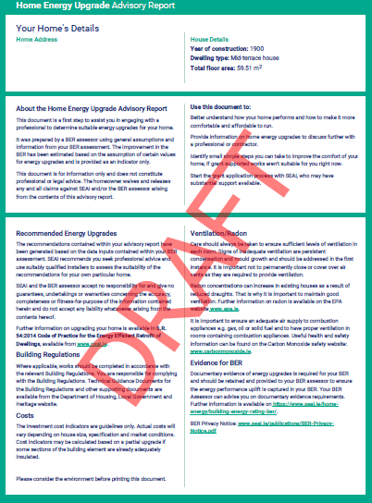

Slide 55
Important
Advisory Report is a starting point
If working with a homeowner, will need to generate a more accurate picture of impact of measures in DEAP

Slide 57
Further Worked Examples

Slide 58
Starting rating: D2

Slide 59
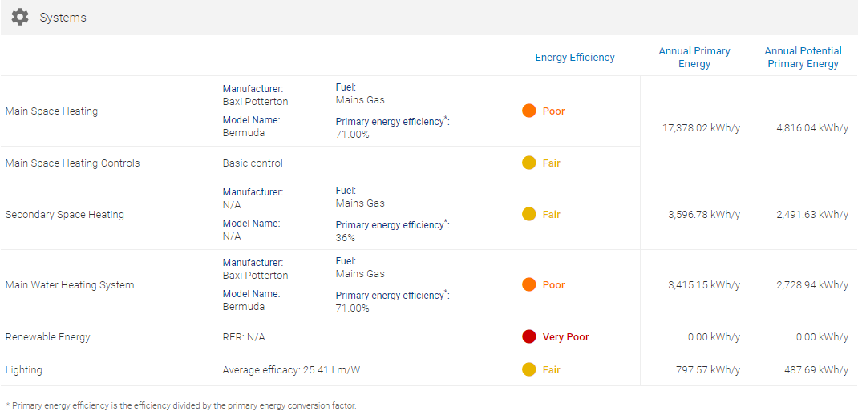
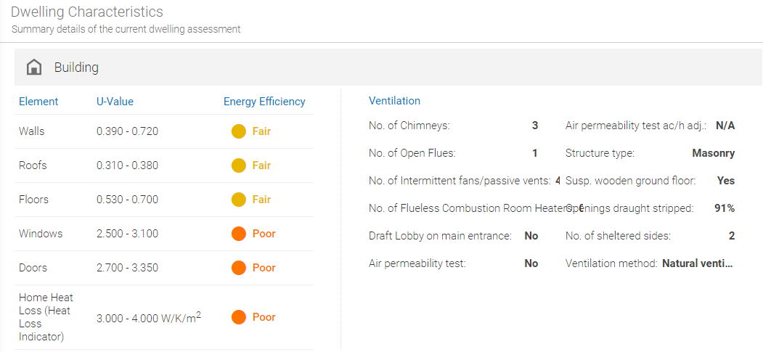
Starting rating: D2

Slide 60
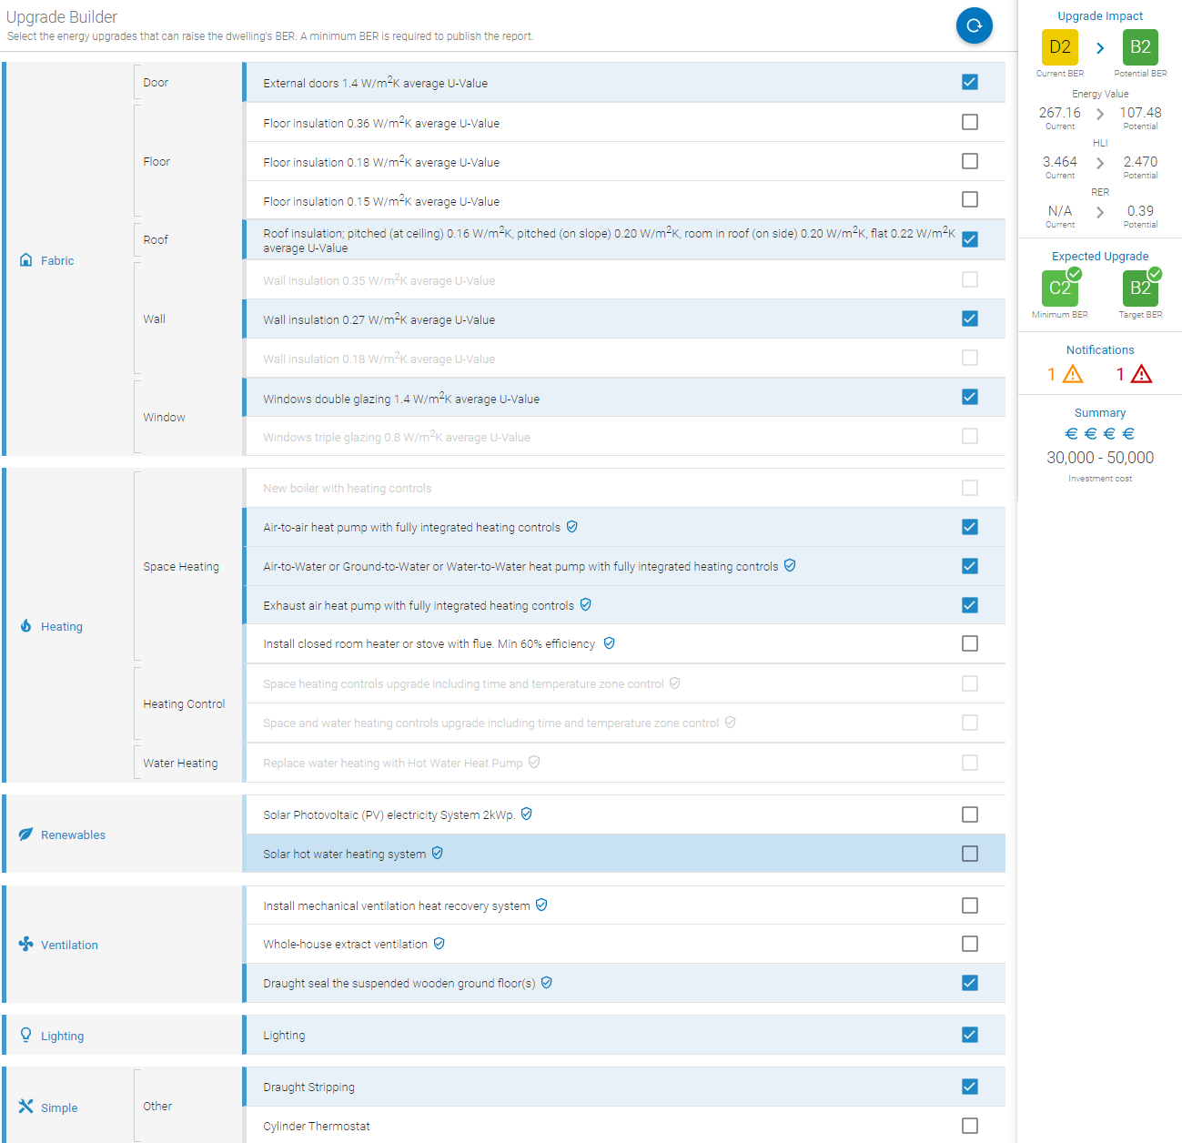

Slide 61
External Doors
Roof Insulation
Wall Insulation (0.27 W/m²K)
Windows (1.4 W/m²K)
Heat Pump options
Draught-seal suspended timber floor
Lighting
Draught Stripping
Cylinder thermostat

Slide 62
Selected measures bring the rating from D2 to a B2
Selected measures bring the rating to 107.48 kWh/m²/yr
Selected measures bring the HLI to 2.470
Selected measures give an RER of 0.39
Achieved Minimum required BER and Target BER
2 notifications – 1 Warnings, 1 Error
Indicative level of investment to implement all selected measures

Slide 63
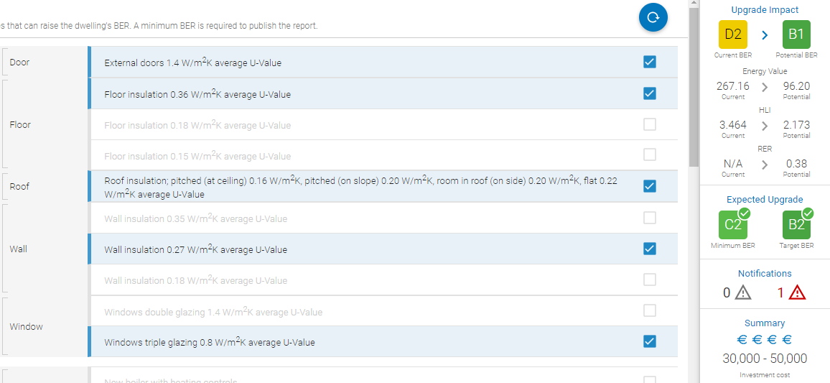

Slide 65
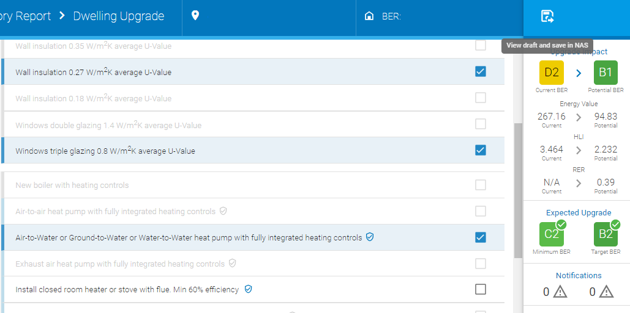

Slide 66
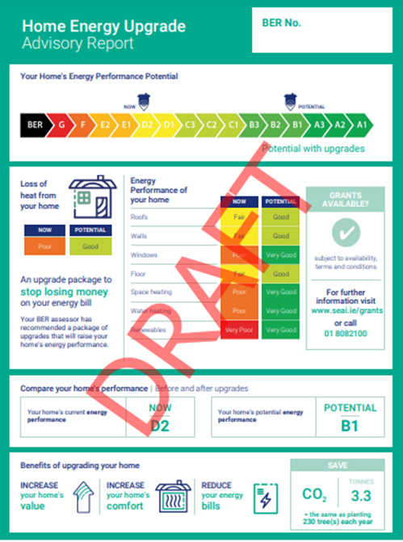
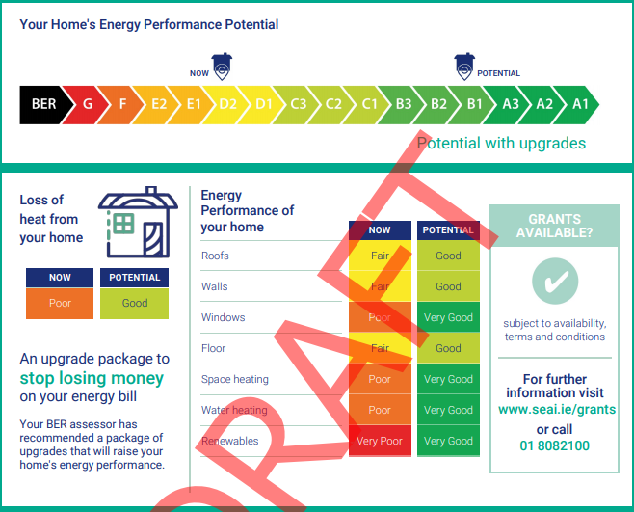

Slide 67
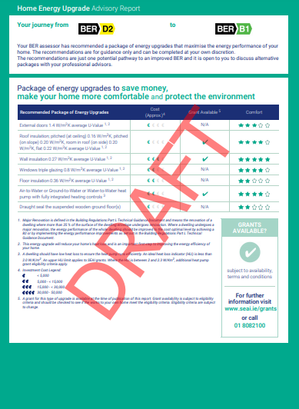
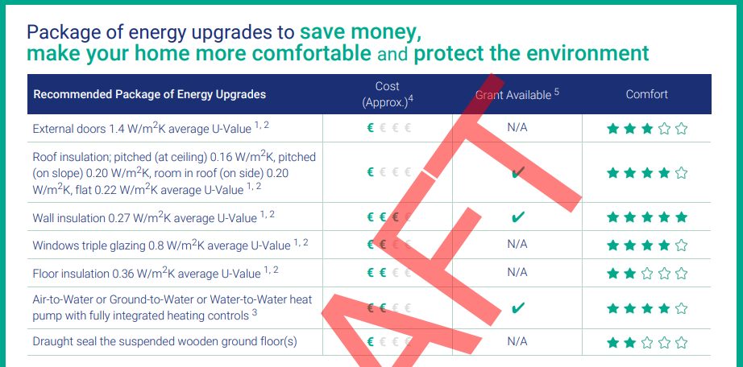

Slide 68
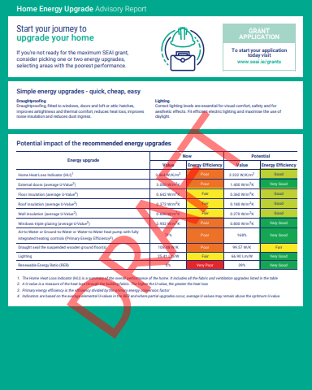
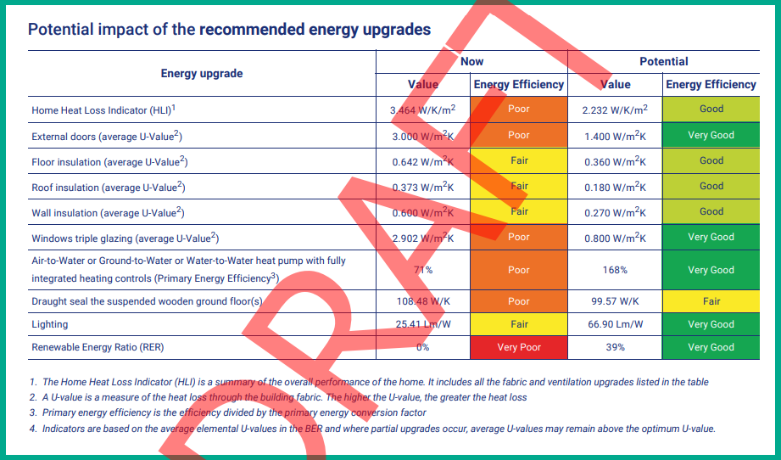

Slide 69
Starting rating: B2

Slide 70
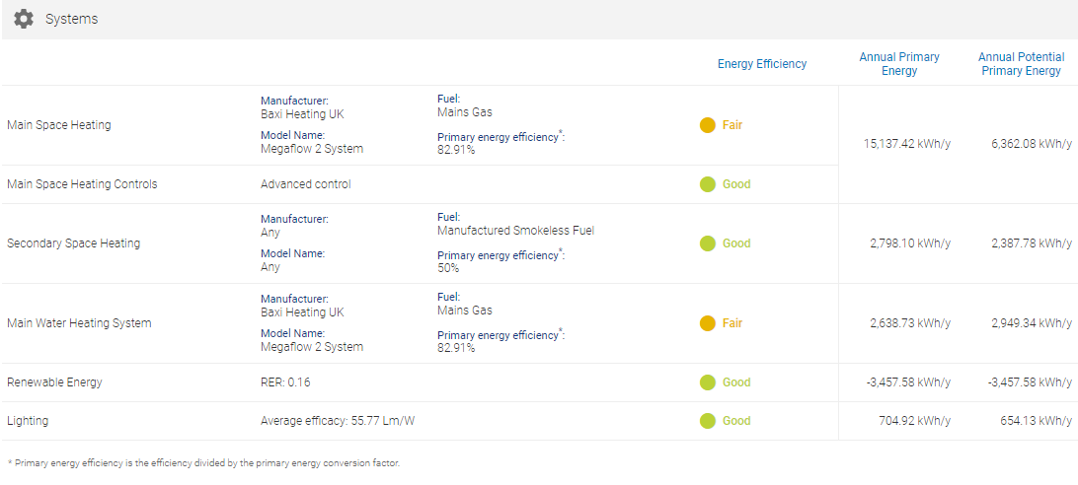
Starting rating: B2

Slide 71
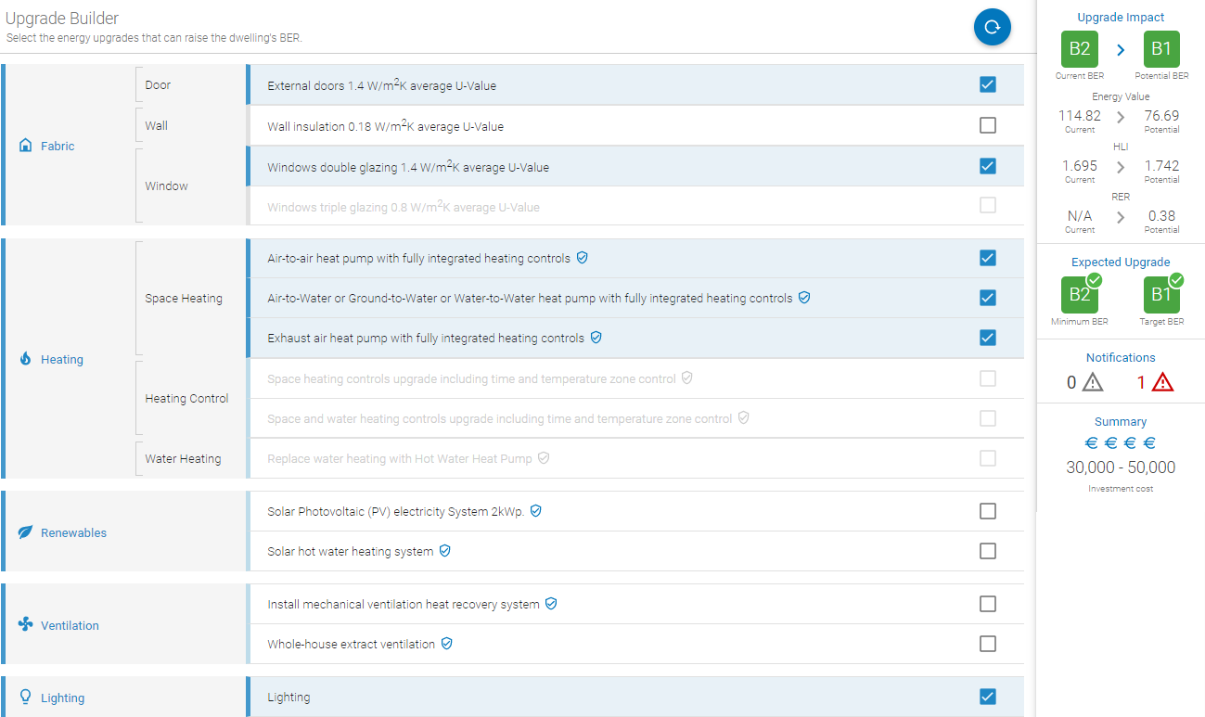
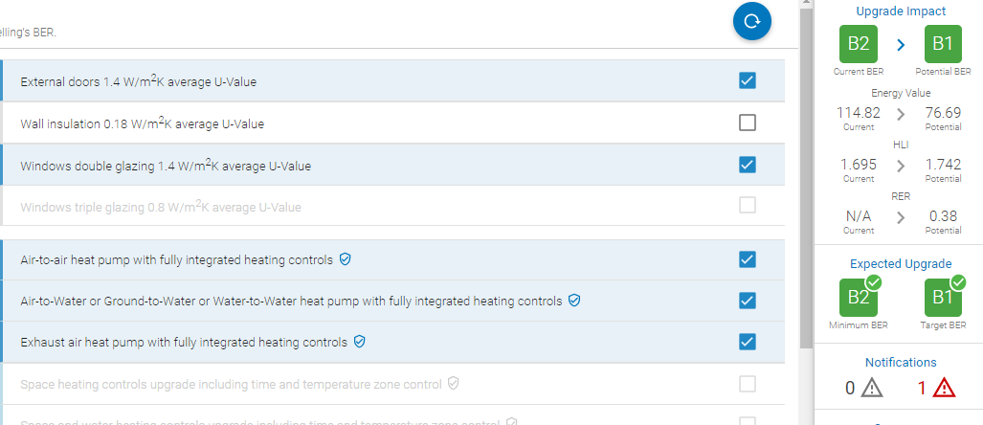
Starting rating: B2

Slide 72
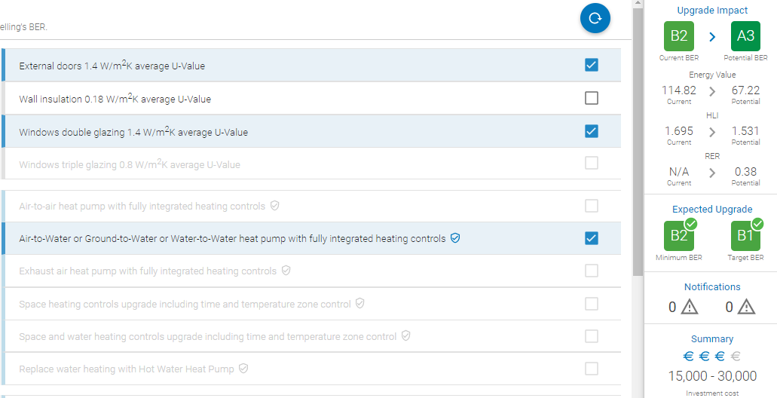
Starting rating: B2

Slide 73
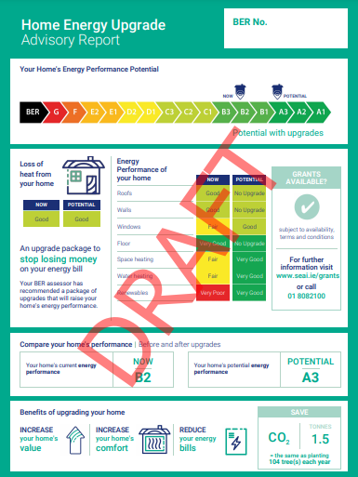
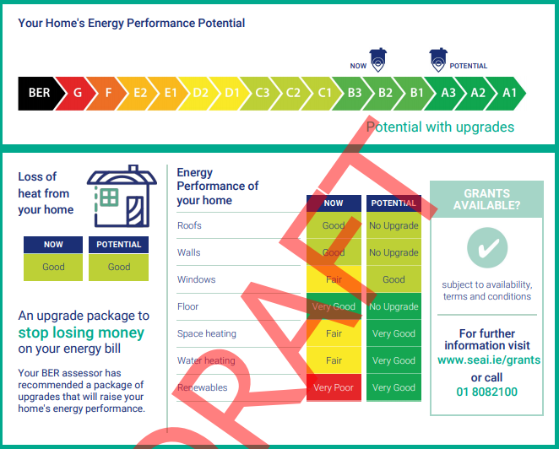

Slide 74
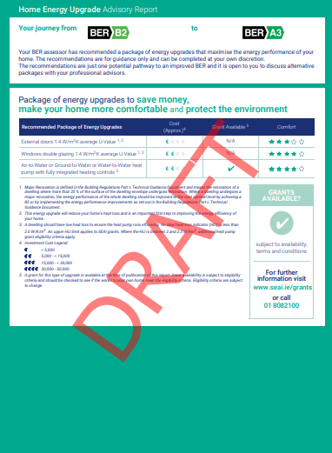
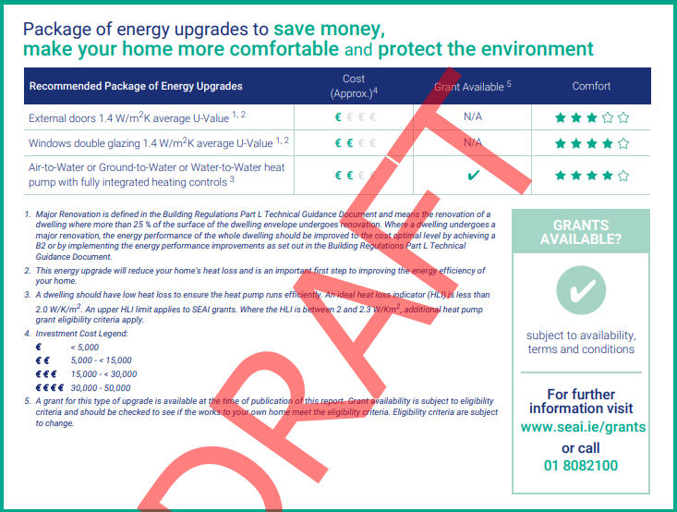

Slide 75
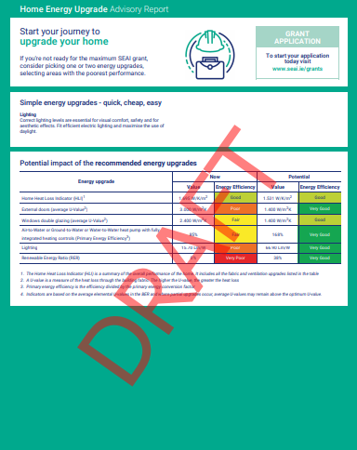
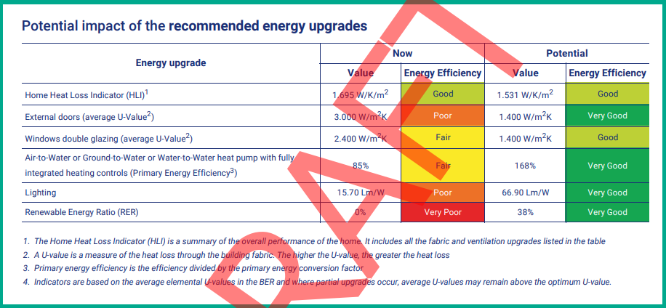

Slide 76
Starting rating: A2

Slide 77
Starting rating: A2

Slide 78
Starting rating: A2

